Slide 1
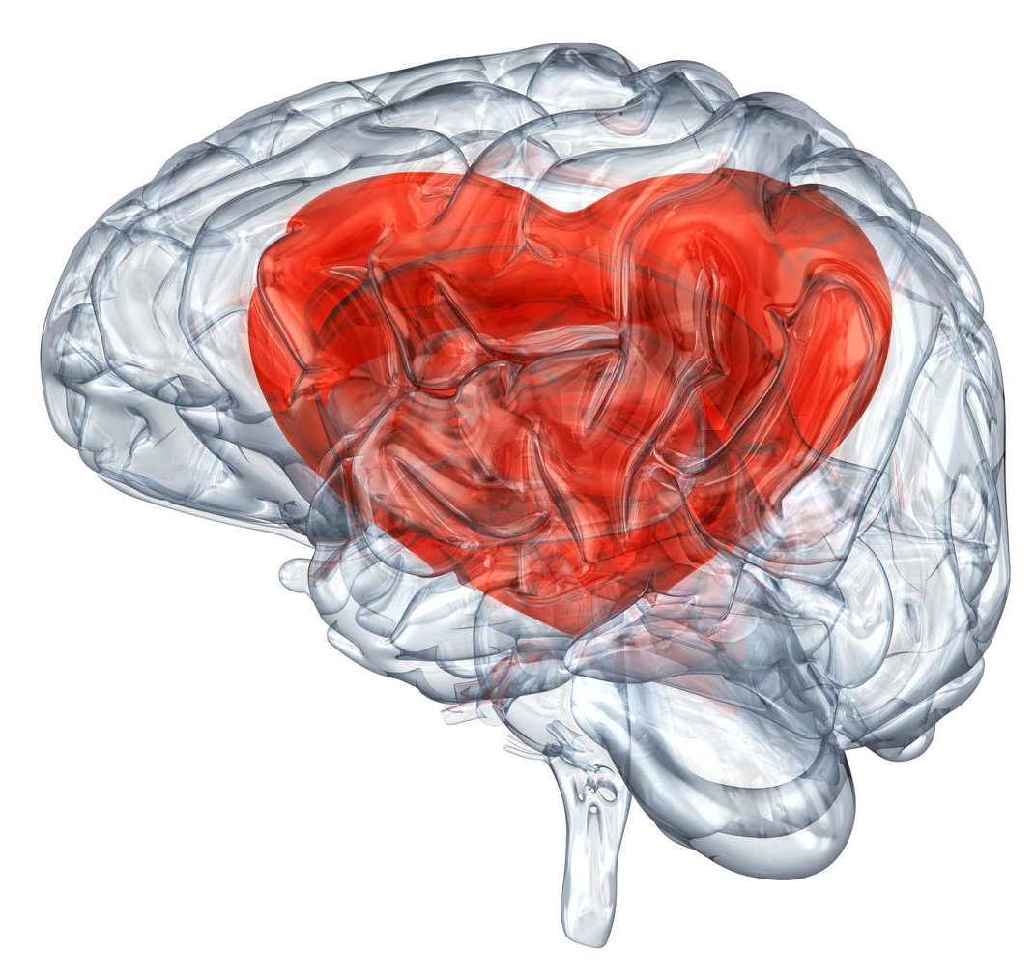
THE LOVE OF NEUROSCIENCE
NSA Journal Club
Presented by: Tyler Short

Slide 2
TABLE OF CONTENTS
01
02
03
04
HIND
SIGHT
INTRO-
SPECTION
FEED-
FORWARD
NEURAL
PATHWAY
What is Neuroscience? How’d we get here?
What is intelligence? Are Humans special?
Where are we now? Where are we going?
What does this mean for/to you?

Slide 3
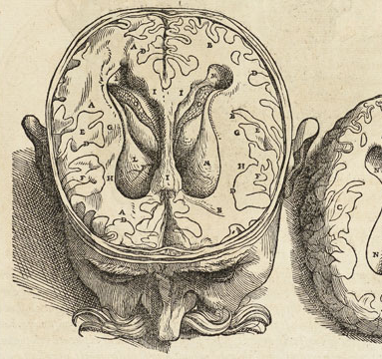
01
HISTORY
BCE - AD

Slide 4
SCIENCE TIMELINE
1700 BC
1849-1861
500-350 BC
1873-1906
First written record about the nervous system
Helmholtz - measures speed of nerve impulses; Broca - localization;
Nerves dissected, "visual rays" theorized, Hippocrates & Plato: Brain → Intelligence
Golgi & Cajal: Cellular Structure of the Nervous System

Slide 5
EVOLUTION
Homo sapiens first appeared ~200,000 years ago; what made us different from the Neanderthals, or Denisovans, or any other hominin or animal? Here’s some explanations:
Social Brain Hypothesis: human intelligence did not evolve primarily as a means to solve ecological problems, but rather as a means of surviving and reproducing in large and complex social groups
Sexual Selection Hypothesis: Smart is sexy!
Ecological Dominance-Social Competition:: An autocatalytic social arms race was initiated, which eventually resulted in the unusual collection of traits characteristic of the human species, such as extensive biparental care, complex sociality, and an extraordinary collection of cognitive abilities.
Group Selection Theory: Characteristics that provide benefits to a group (clan, tribe, or larger population) can evolve despite individual disadvantages such as those cited above.

Slide 6
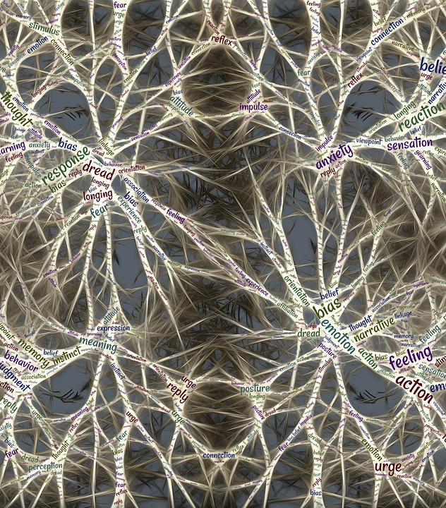
02
INTELLIGENCE
Qualia, Intentionality, & Philosophy of Mind

Slide 7

QUALIA
“What’s It Like To Be -?”
Inverted Spectrum Argument
Zombie Argument
Knowledge Argument
Thomas Nagel's paper "What Is it Like to Be a Bat?"
Credited to John Locke
Associated with David Chalmers
Also known as Mary's room

Slide 8
QUALIA
INTENTIONALITY
“...cognition depends upon the kinds of experience that come from having a body...”
The Embodied Mind: 1991—
“Man can do what he wills but he cannot will what he wills.”
—Arthur Schopenhauer

Slide 9
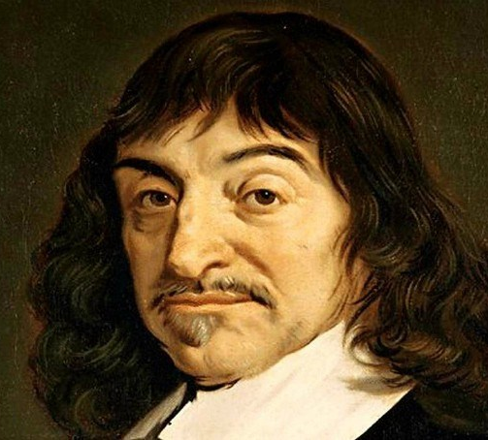
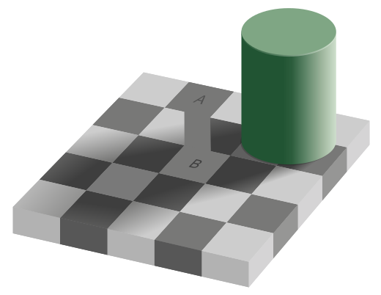
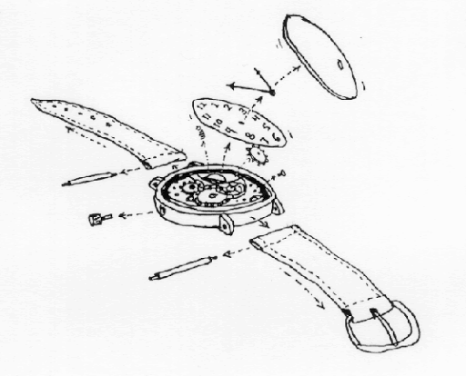
PHILOSOPHY OF MIND
Cogito, ergo sum
Perception
Reductionism
Descartes’ "I think, therefore I am"
Perception requires a commitment to an ontological or metaphysical view
Can we investigate brain on a small enough scale to ever understand?

Slide 10

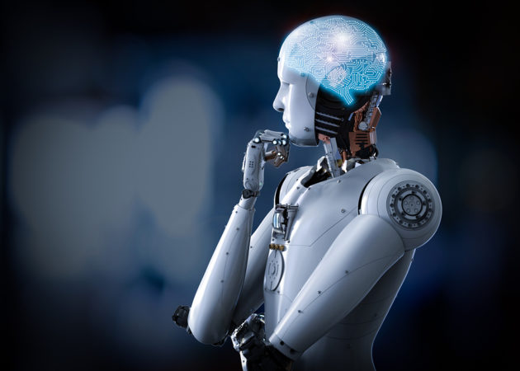
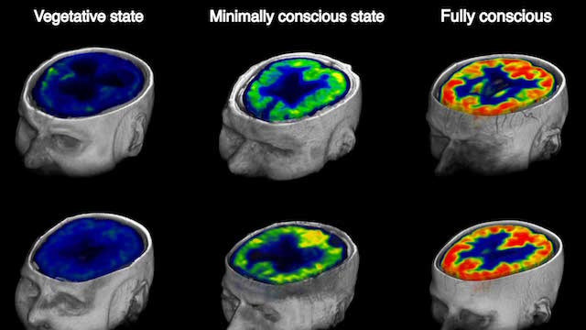
PHILOSOPHY OF MIND
Naturalism
Emergence
Consciousness
Can everything be explained by laws of physics/chemistry
Is intelligence, cognition, or consciousness a gradient or binary?
How unique is subjective experience?

Slide 11
Attention Schema Theory
Broad Points
Theory & Support
The brain is an information-processing device
Focus may be on select, incoming signals, or on internal information such as memories. That ability can be called attention.
The brain uses the processes of attention, and builds a representation of attention
Essentially, “consciousness” can be explained as the brain’s model of attention
Graziano developed the theory of the body schema
Like the body schema, it’s a simplified representation

Slide 12
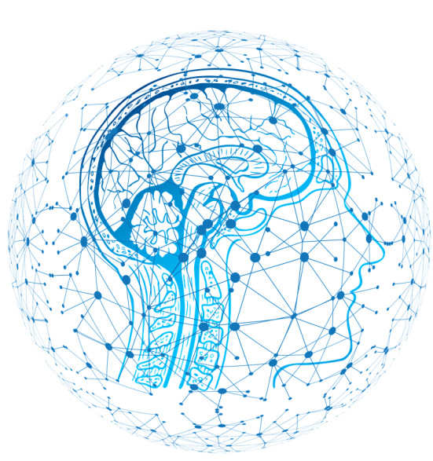
03:
MAJOR BRANCHES
A few examples of neuroscience fields of research

Slide 13

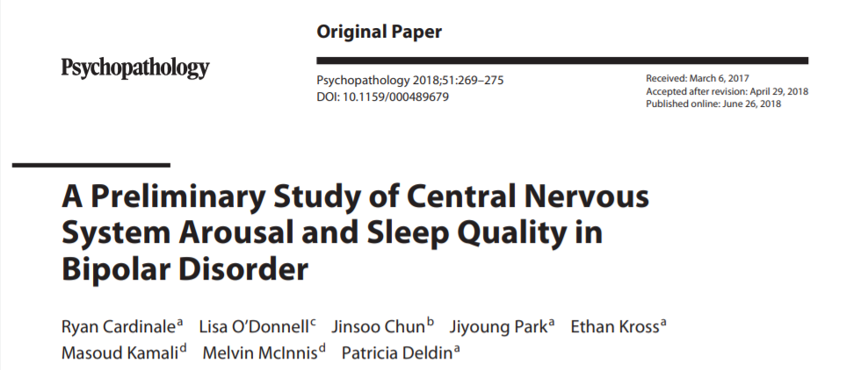
AFFECTIVE NEUROSCIENCE
Dr. Jiyoung Park
The Culture & Affective Neuroscience Lab (CANLab)
https://utdcanlab.weebly.com/
How neurons behave in relation to emotion
Focuses on the neural bases of emotions, and assumes a role of great relevance for emotions and affects in the modulation of cognition and behavior
Almada LF, Pereira Jr A, Carrara-Augustenborg C. What Affective Neuroscience Means For Science Of Consciousness. Mens Sana Monogr 2013;11:253-73

Slide 14


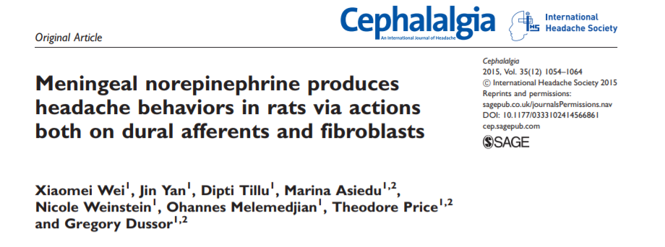
CLINICAL NEUROSCIENCE
Dr. Greg Dussor & Dr. Ted Price
Pain Neurobiology Research Group
https://bbs.utdallas.edu/painneurosciencelab/index.html
Researching disorders of nervous system to find ways to treat and prevent them
Investigating biomarkers
Improving psychiatric diagnosis
Discovering new treatments for pain
Treating disorders of immunity or inflammation
Treating addictive disorders
Young, Anne; McArthur, Justin; Mobley, William.“A Ten-Year Plan for Neuroscience: From Molecules to Brain Health” One Mind for Research

Slide 15

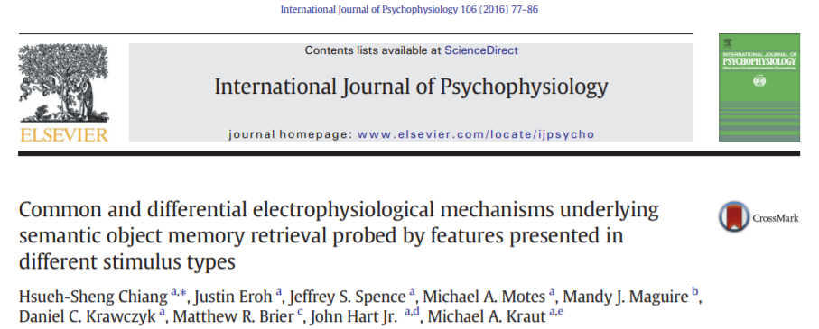
COGNITIVE NEUROSCIENCE
Dr. John Hart
Cognitive Neuroscience Laboratory of Memory
https://www.utdallas.edu/memory/
How the brain forms and controls thoughts and the neural factors that underlie those processes
Combines measurement of brain activity with a simultaneous performance of cognitive tasks by human subjects
Pereira, Alfredo Jr. “What the cognitive neurosciences mean to me.” Mens sana monographs vol. 5,1 (2007): 158-68. doi:10.4103/0973-1229.32160

Slide 16
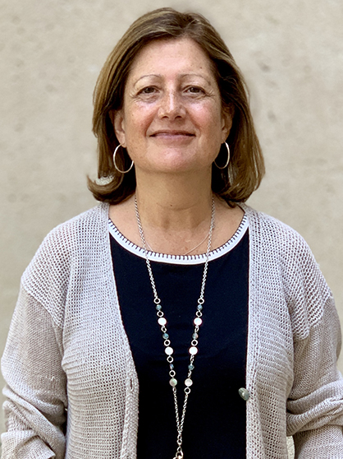
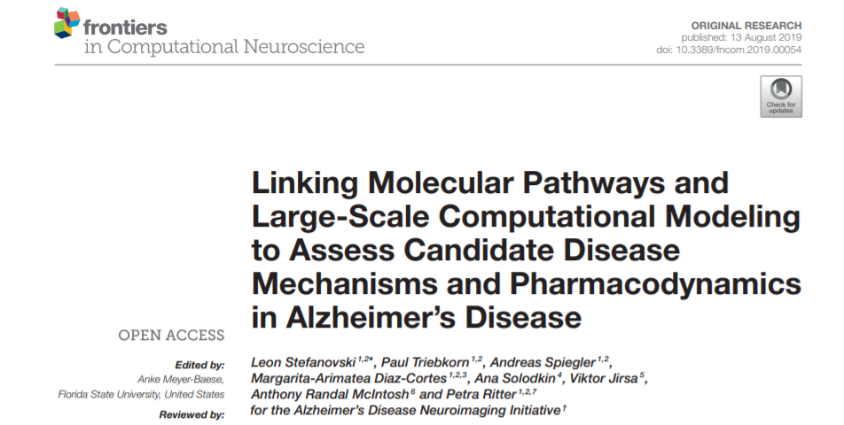
COMPUTATIONAL NEUROSCIENCE
Dr. Ana J. Solodkin
Active Partner of TheVirtualBrain (TVB) consortium
https://bbs.utdallas.edu/faculty/detail.php5?i=2036
Uses math, theory, and abstractions of the brain to understand the principles that govern the development, structure, physiology, and cognitive abilities of the nervous system
What is computational neuroscience? Patricia S. Churchland, Christof Koch, Terrence J. Sejnowski. in Computational Neuroscience pp.46-55.

Slide 17
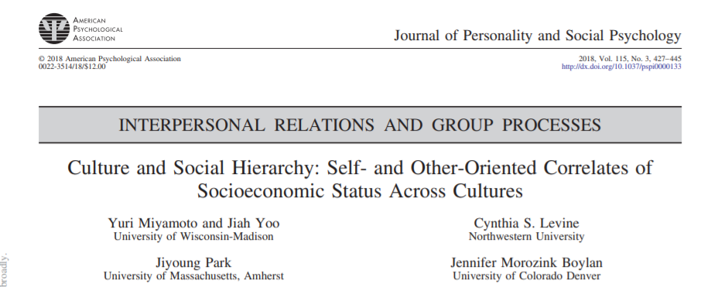
CULTURAL NEUROSCIENCE
Interaction between cultural factors and genomic, neural, and psychological processes
Motivated by two intriguing questions of human nature:
How do cultural traits shape neurobiology and behavior?
How to neurobiological mechanisms facilitate the emergence and transmission of cultural traits?
Dr. Jiyoung Park
The Culture & Affective Neuroscience Lab (CANLab)
https://utdcanlab.weebly.com/
Joan Y, Chiao, Ahmad R. Hariri, et al. Theory and methods in cultural neuroscience. Soc Cogn Affect Neurosci. 2010 Jun-Sep; 5(2-3): 356-361

Slide 18

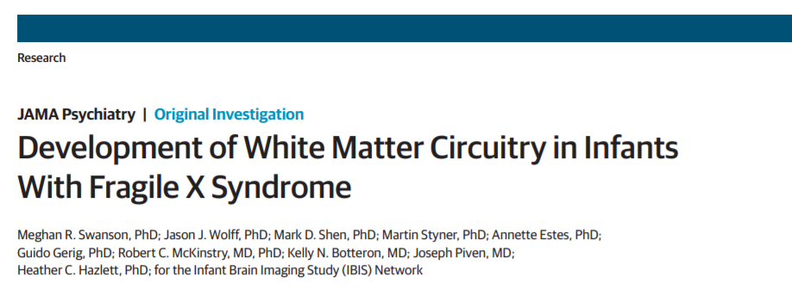
DEVELOPMENTAL NEUROSCIENCE
How the brain and nervous system grow and change, from conception through adulthood
Key questions:
Patterning and fate specification of nervous system cells
How developing neurons and glia are able to organize themselves and assemble
How connections between cells are formed and refined over the course of development
Dr. Meghan Swanson
Baby Brain Lab
The Infant Neurodevelopment and Language Research Lab
https://labs.utdallas.edu/babybrainlab/
Journal of Visualized Experiments: Science Education Collection. “An introduction to Developmental Neurobiology” : https://www.jove.com/science-education/5207

Slide 19


MOLECULAR & CELLULAR NEUROSCIENCE
Leverages molecular biology to explore how genes, signaling molecules, and cellular morphology influence the nervous system
Example Questions:
Which genes influence neuronal function?
Identifying the DNA targets of nervous system-specific transcription factors
How do molecules regulate neuronal behavior?
Dr. Michael D. Burton Neuroimmunology and Behavior Lab
https://labs.utdallas.edu/niblab/
Journal of Visualized Experiments: Science Education Collection. “An Introduction ot Cellular and Molecular Neuroscience” https://www.jove.com/science-education/5213

Slide 20
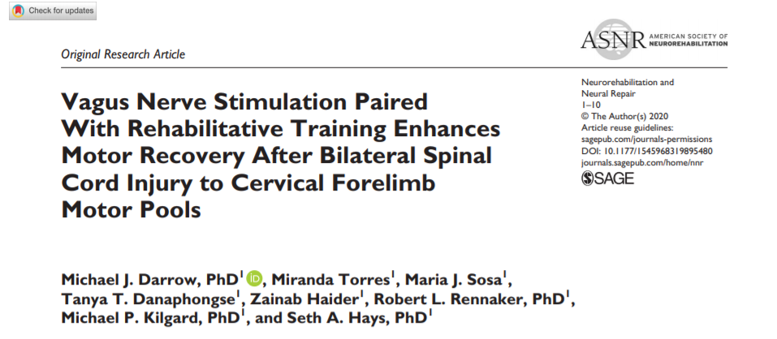
NEUROENGINEERING
The Texas Biomedical & Device Center
https://www.utdallas.edu/txbdc/
Using engineering techniques to better understand, replace, repair or improve neural systems
Prominent goals: restoration and augmentation of human function via direct interactions between the nervous system and artificial devices

Slide 21

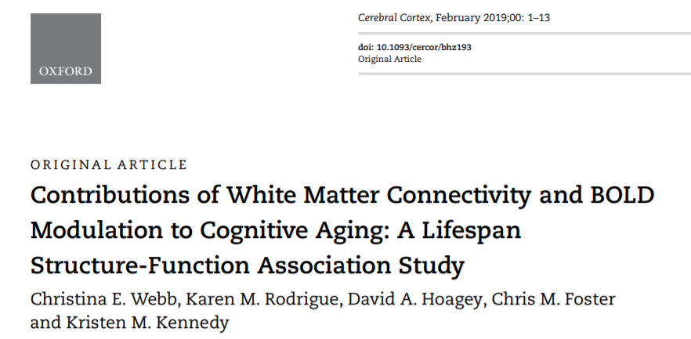
NEUROIMAGING
A branch of medical imaging that concentrates on brain → used to diagnose disease, assess health, study how the brian works and how different activities affect the brain
Anatomical: CT, MRI, etc
Create a snapshot of brain structure
Functional: EEG, MEG, fMRI, PET, etc
Create a series of dynamic snapshots that reflect ongoing brain activity
Dr. Kristen Kennedy
Kennedy Neuroimaging of Aging and Cognition (KNAC) Lab
https://vitallongevity.utdallas.edu/knac/

Slide 22
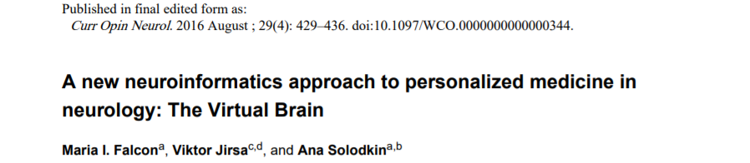
NEUROINFORMATICS
Dr. Ana J. Solodkin
Active Partner of TheVirtualBrain (TVB) consortium
https://bbs.utdallas.edu/faculty/detail.php5?i=2036
Collaboration between computer scientists and neuroscientists → develop ways to collect, analyze, share, and publish data
Core areas of emphasis:
Software tools
Ontologies
Databases
Sridevi Polavaram and Giorgio Ascoli (2015),”Neuroinformatics” Scholarpedia, 10(11):1312

Slide 23

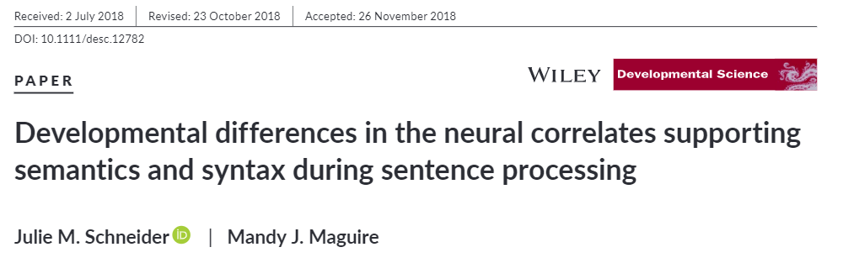
NEUROLINGUISTICS
Dr. Mandy Maguire
Developmental Neurolinguistics Laboratory
bbs.utdallas.edu/brainlab/home.htm
The study of how language is represented in the brain: how and where our brains store our knowledge of the language(s) we speak, understand, read and write, what happens in our brains as we acquire that knowledge, and what happens as we use it in our everyday lives
Lise Menn. “Neurolinguistics” Linguistic Society of America https://www.linguisticsociety.org/resource/neurolinguistics

Slide 24
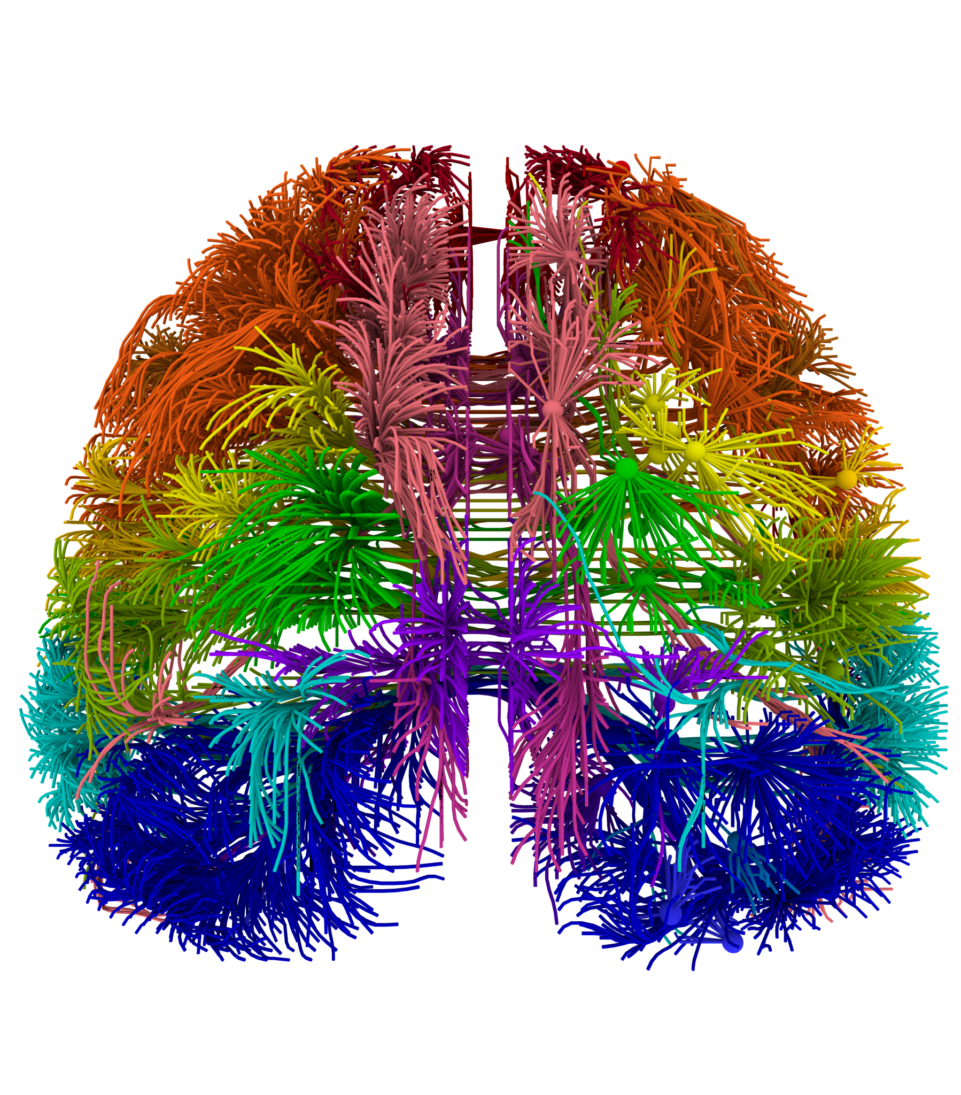
04:
NEUROSCIENCE & YOU
So you really like neuroscience, what can you do about it?

Slide 25
GET INVOLVED
LEARN MORE
RESEARCH
NSA
Take NSC, CGN, PSY, classes
Go to the seminars hosted by BBS
Look online for more information
Get involved with a research lab on campus
Come with us on lab tours
Talk to PIs and grad students
Keep coming to meetings
Give a journal club presentation
Talk to the other members

Slide 26
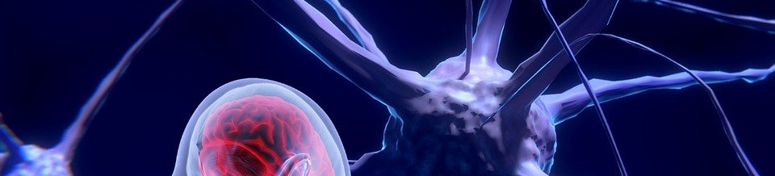
THANKS

